Slide 1
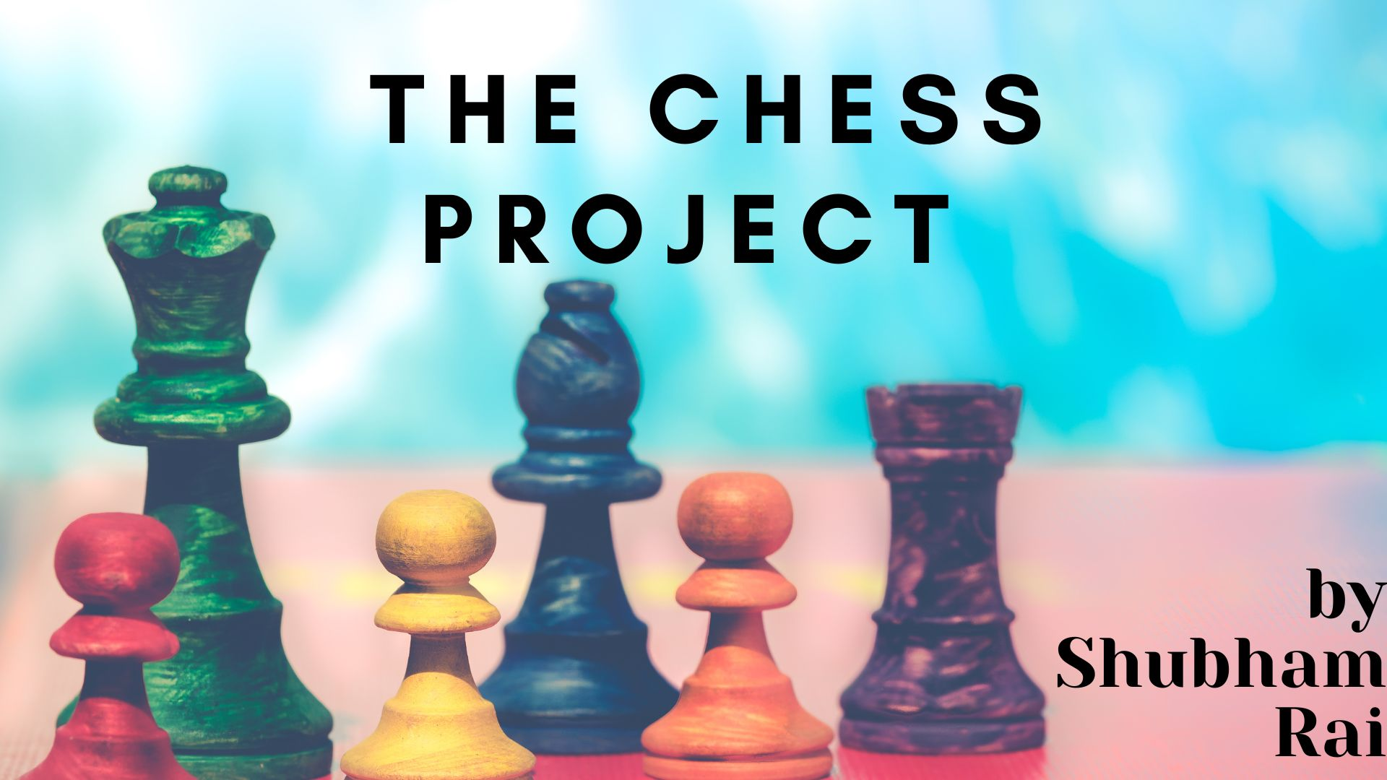

The Chess Project
THE CHESS
PROJECT
Shubham Rai | Dr Sanjay Singh | RSMT, Varanasi

Slide 2
How to design a chess playing environment? How to design a ML based chess playing program?
Make a project that allows players to play chess online, store those moves, train a model and then make a chess playing ML bot
Notes:
This is the question that your experiment answers

Slide 3
Overview of the Chess Project
Create a HTML-5, CSS based user interface through which 2 players can play a chess game.
Provide an interactive user experience and validation using Javascript.
Store the moves and transfer them to a MySQL database.
Use Python to train a ML bot using the saved data.
Launch the ML bot to play with human players.

Slide 4
Milestones
Create the UI using HTML-5 and CSS
Create User Experience and Validation using Javascript
Store data in a MySQL database. Initial Storage will be in localStorage in the browser.
Train a Python ML bot using the saved data
Launch the ML based player
Notes:
Summarize your research in three to five points.

Slide 5
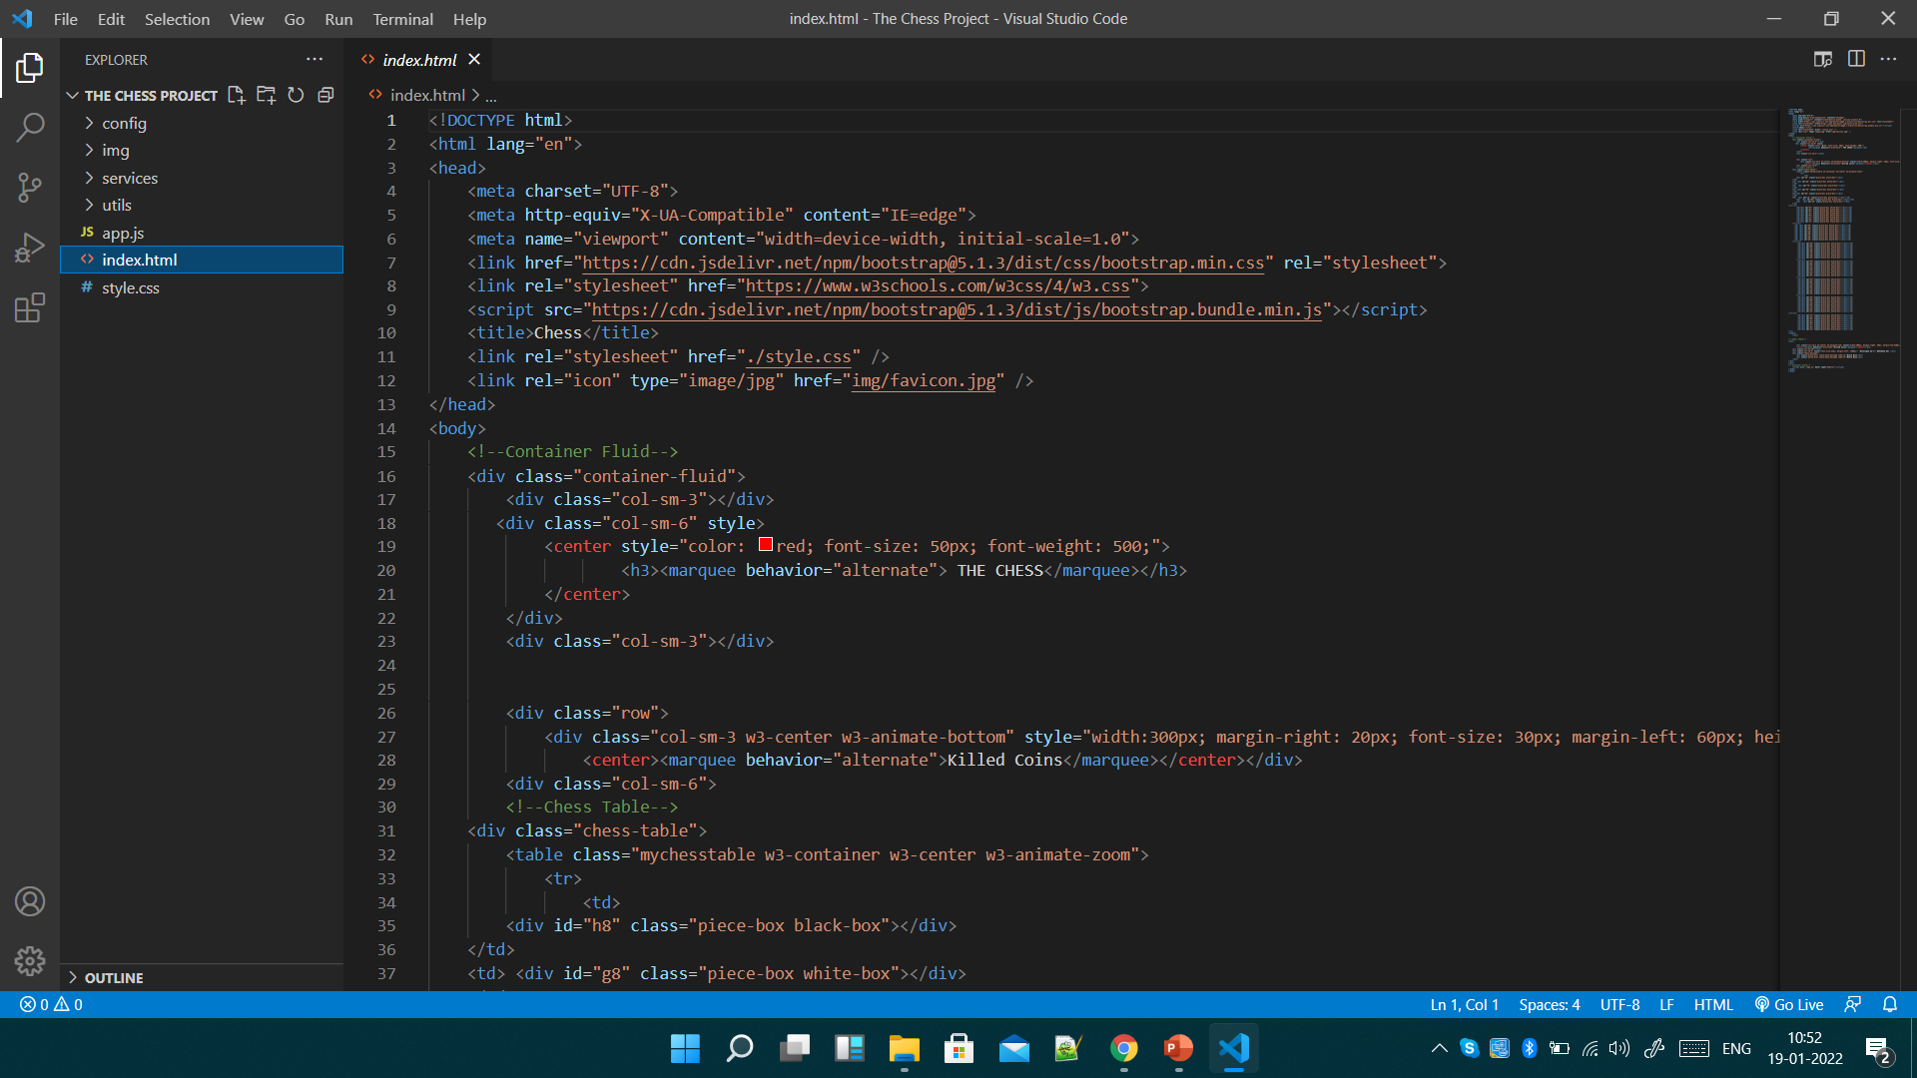
Add your answer / solution here
Index.html is the main home page which helps users to interact with the help of the css and js files.
Notes:
Establish hypothesis before you begin the experiment. This should be your best educated guess based on your research.

Slide 6
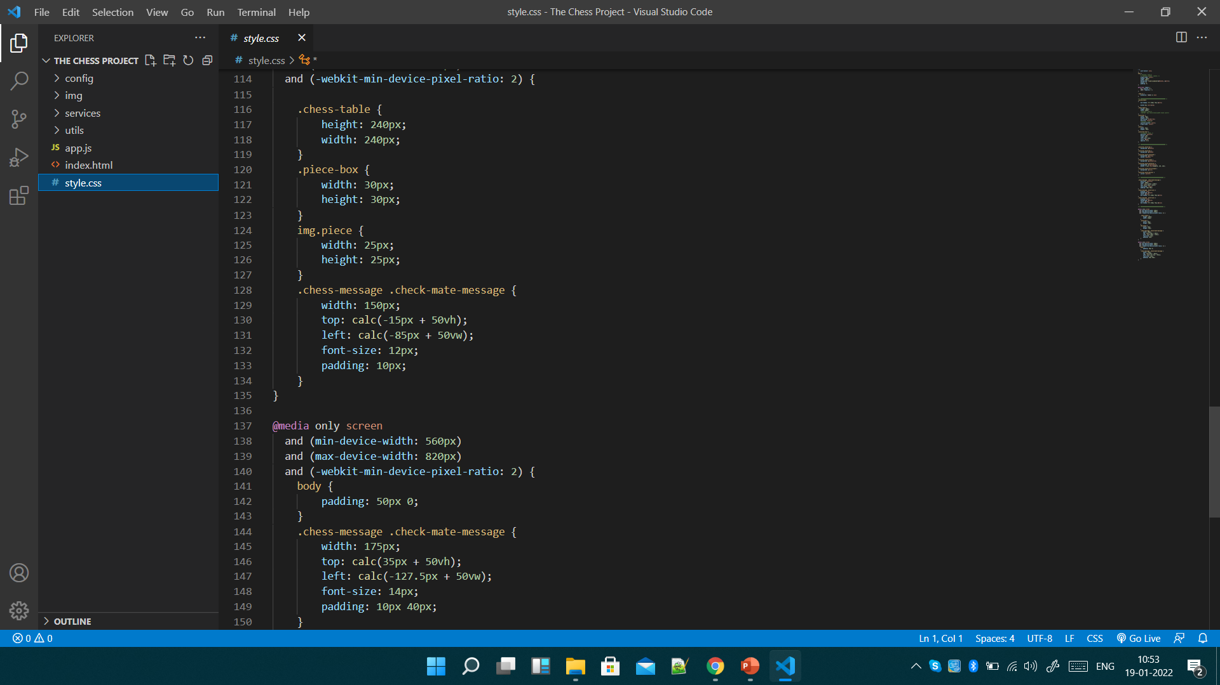
Add your answer / solution here
style.css manage the styling of the html page.
Notes:
Establish hypothesis before you begin the experiment. This should be your best educated guess based on your research.

Slide 7
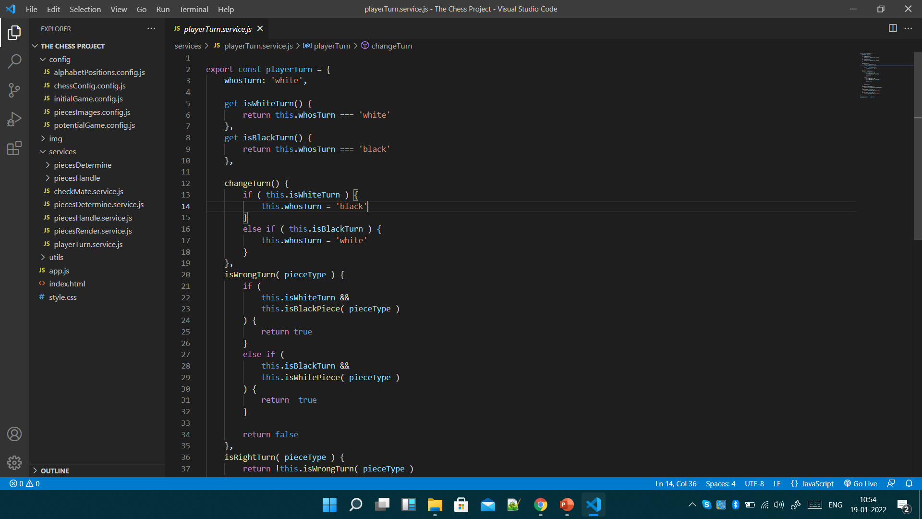
Add your answer / solution here
JavaScript Manages the Positioning , Handling , Movements , Right / Wrong turns of the Pieces.
Notes:
Establish hypothesis before you begin the experiment. This should be your best educated guess based on your research.

Slide 8
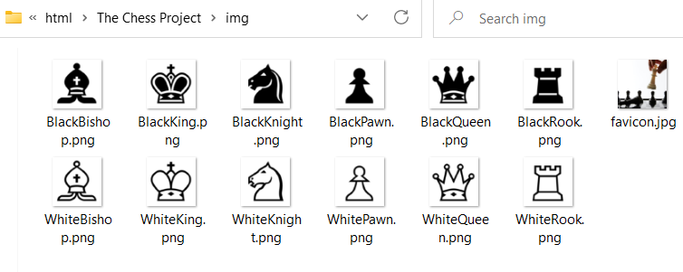
HTML Code:
Chess Board
Chess Pieces
Pieces Position
Table 8 X 8 for the chess board
Chess pieces are png files.
The positions are stored as JavaScript objects.
Placement is by div inside td.
<div class="chess-table">
'a8': 'black_rook',
'b8': 'black_knight’,…..
'white_pawn': './img/WhitePawn.png',
'white_rook': './img/WhiteRook.png',
Initialgame.config.js

Slide 9
Events:
'mouseenter':
'mouseleave':
'click':
This event remove highlighting when mouse cursor will be removed from that place.
This event highlights the possible move positions
This event Highlight the position in yellow is done by css

Slide 10
CSS. [Name of file is style.css]:
Classes:
Some Classes Names:
files:
21 classes are created in style.css
Only one file. Style.css
.chess-table
.piece-box
.img.piece
.mychesstable
.chess-message
.check-mate-message and so on

Slide 11
Java Script:
Files:
Directories:
Details:
3 folders are available to store JS files.
Config it have 5 js files.
Config holds all the initial js files which identifies the positions of pieces and the link of the png files of pieces.
Services it holds 2 folders and 5 js files.
Utils it contains only one js files.
Services Directory manage the pieces determinations, pieces handling , and the players turns/movement.
app.js file helps to run the functions automatically.
Utils have only one js file which provides search queries and object cloning

Slide 12
Chess DFD [Level 0]:
Software
move
move
Player 1
Player 2
response
response
Notes:
Summarize your research in three to five points.

Slide 13
Chess DFD [Level 1]:
move
Chess
move
Player 1
Player 2
response
response
Player 2 turn
DataBase
Player 1 turn
move
response
response
move
Check Players turn
Determination
current state , move
move
Game state
Move Validation
response
Game State
Valid move
checkmate
Game Over
Notes:
Summarize your research in three to five points.

Slide 14
ML DFD [Level 0]:
ML /
Module
Game State
Game State
Player
Admin
Suggested move
response
Notes:
Summarize your research in three to five points.

Slide 15
ML DFD [Level 1]:
Game State
ML /
Module
Game State
Player
Admin
Suggested move
Acknowledgement
Suggestion
Game State
Update
DataBase
Search for valid move
Move found
Not found
Generate Random moive
ACK
ACK
Notes:
Summarize your research in three to five points.

Slide 16
DFD:
Load HTML File
Import app.js
import { piecesRender } from './services/piecesRender.service.js’
After Dom contents are loaded call renderPieces
Check chessConfig.useInitialGame property and load initial game or potential game.
ChessConfig is in the config folder. InitialGame is in the same folder also potentialgame
Both initial game and potential game contain the starting state of the board
this.placePieceBoxNumbers()//Place piece box numbers in every piecebox div
Notes:
Summarize your research in three to five points.

Slide 17
DFD:
addPiecesBoxListeners()
Add listeners to all piece positions
Import app.js
import { piecesRender } from './services/piecesRender.service.js’
After Dom contents are loaded call renderPieces
Check chessConfig.useInitialGame property and load initial game or potential game.
ChessConfig is in the config folder. InitialGame is in the same folder also potentialgame
Both initial game and potential game contain the starting state of the board
this.placePieceBoxNumbers()//Place piece box numbers in every piecebox div
Notes:
Summarize your research in three to five points.

Slide 18
Procedure
Step 1
Describe this step in your experiment
Step 2
Describe this step in your experiment
Step 3
Describe this step in your experiment
Step 4
Describe this step in your experiment
Notes:
List all of the steps used in completing your experiment.
Remember to number your steps.

Slide 19
Testing:
Extensive Black-box testing is done

Slide 20
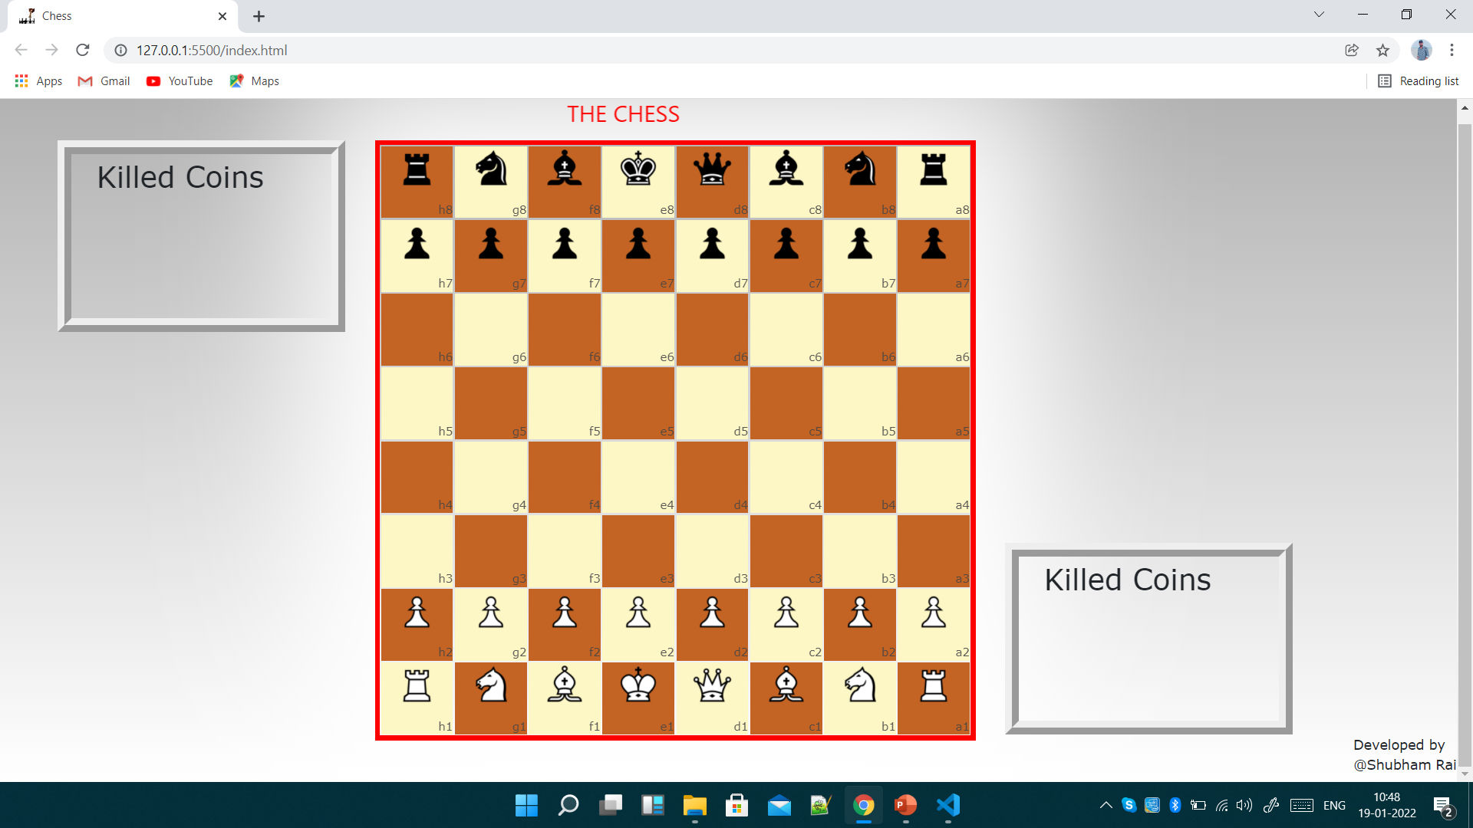
Result:
Notes:
Summarize your research in three to five points.

Slide 21
Future Scope:

